Slide 1

Global Development Measurement
Data Science Project-241 Group: 06
Mentor: Snehal
2023-05-22
Team Members:
Ms.Krithi Pendem
Mr. Dinesh Kumar .G
Mr. Pushkar Manohar Chaudhari
Mr. Yash Vishnu Sarowar
Mr. Ramavat Sri Krishna
Mr. Aishwary Pradhan
Mr. DSN Raju

Slide 2
Business Problem:
Creating clusters on global development measurement data.
Objective:
Performing the EDA and Feature Engineering on our Dataset.

Slide 3
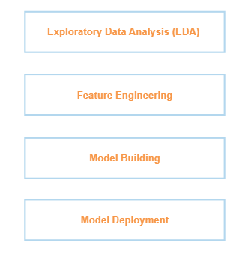
Project Architecture / Project Flow

Slide 4
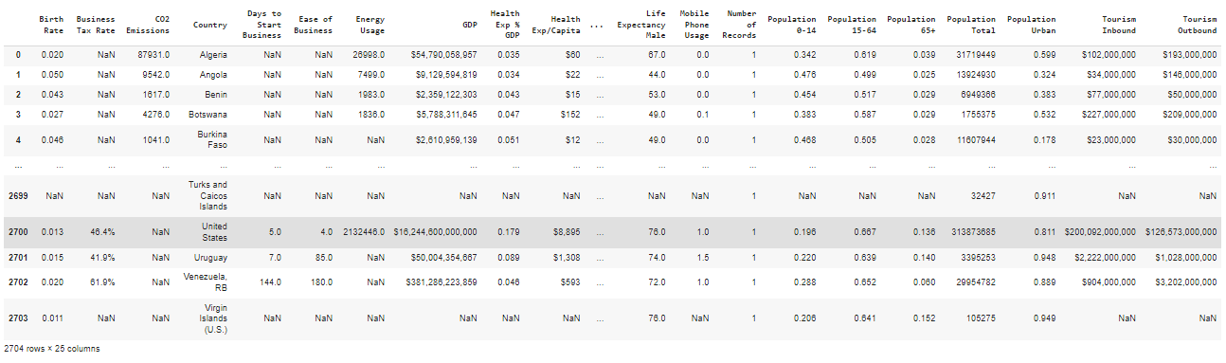
Data Set Details
Number of Columns: 25, Number of Rows: 2704
Objects: 06 (Business Tax Rate, GDP, Country(Categorical Variable), Health Exp / Capita, Tourism Inbound and Tourism Outbound)
There are no Duplicate Values

Slide 5
Exploratory Data Analysis (EDA) and
Feature Engineering

Slide 6
Exploratory Data Analysis (EDA)
The Symbols present in the dataset have been removed such as
(“%”, “$”, “,”). From the variables: Business Tax Rate, GDP, Health Exp/Capita, Tourism Inbound and Tourism Outbound.
The only 02 variables without any missing values are
GDP and Total Population amongst the data.

Slide 7
Feature Engineering
The Dropped Columns: “ Ease of Business” and “Number of Records”
The treatment of missing values was performed.
The Visualisation of Data Distribution has been performed through a “Histogram”
Outlier Detection has been done using Box Plots
A Correlation was done between the variables and a Heat Map has been generated to show the highest correlation between each variable.
Correlation Insights:
Birth Rate has Strong Positive Correlation with 05 Variables.
Co2 Emission has Strong Correlation with 05 Variables.
Ease of Business has a Negative Correlation with 01 Variable.
Usage Energy Usage has Positive Correlation with 04 Variables.
Usage Energy Usage has Positive Correlation with 04 Variables.
GDP has a Positive Correlation with only a single variable.

Slide 8
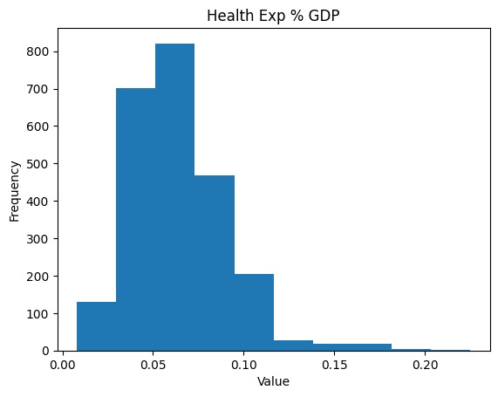
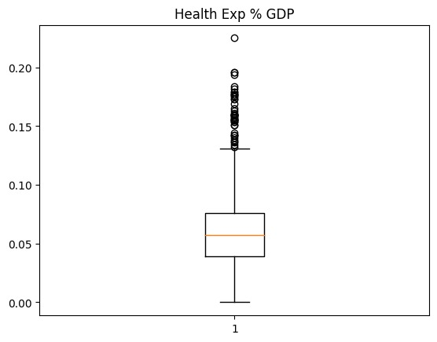
Histograms and Box Plots
Feature Engineering

Slide 9
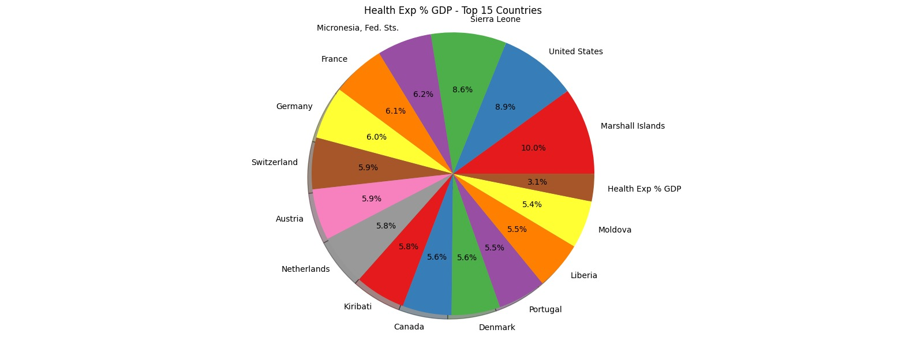
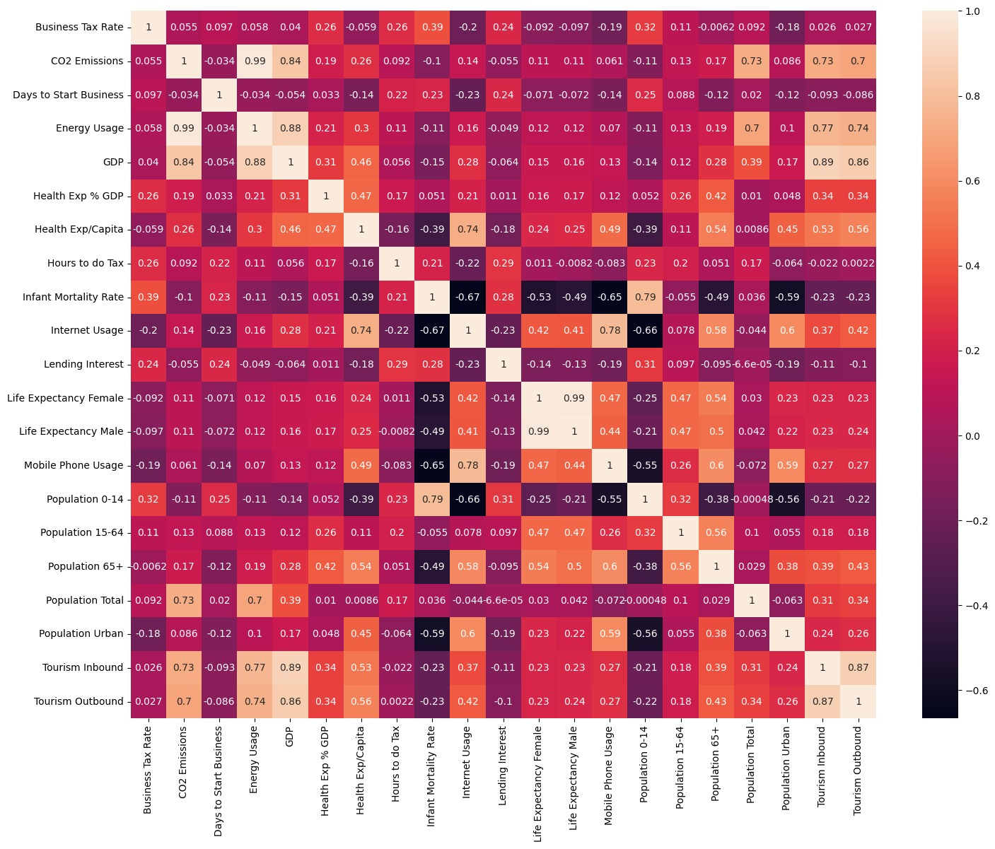
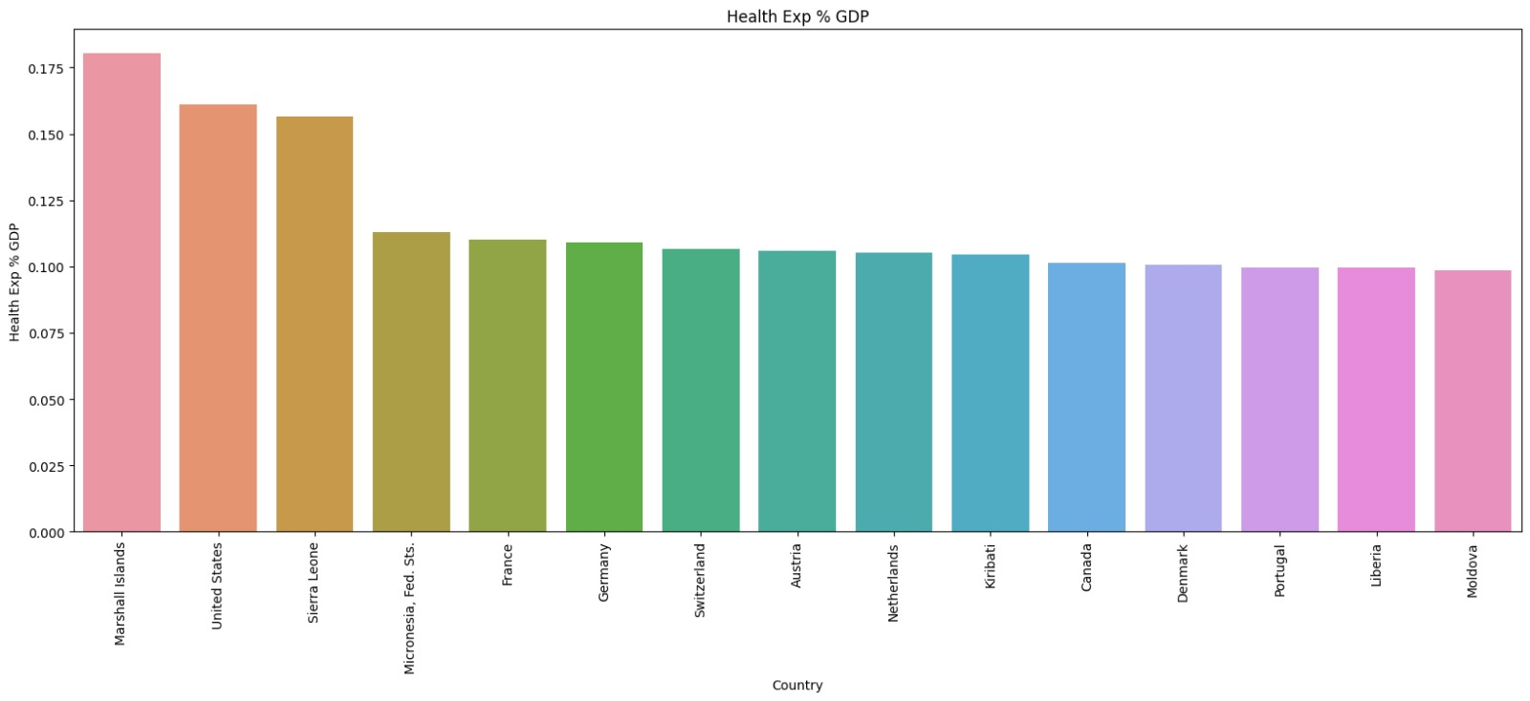
Feature Engineering
Heat Map - Pie Charts - Bar Charts

Slide 10
Model Building

Slide 11
Model Building
Outlier Number and Percentage has been calculated for each column in the DataFrame by using the median value of the specific column.
Outlier treatment was performed.
Range of Limits for each variable was obtained.
Density Plot visualization was implemented to understand the distribution of the data, shape, central tendency and spread of a dataset.
QQ Plot graphical tool was used to assess whether a dataset follows a specific probability distribution & for diagnosing deviations from normality (skewness and heavy tails), identifying outliers and assessing the appropriateness of statistical models that assume normality.
By examining the QQ plot, we can observe if the 'GDP' data points fall along a straight line (indicating they are normally distributed) or deviate from it.

Slide 12
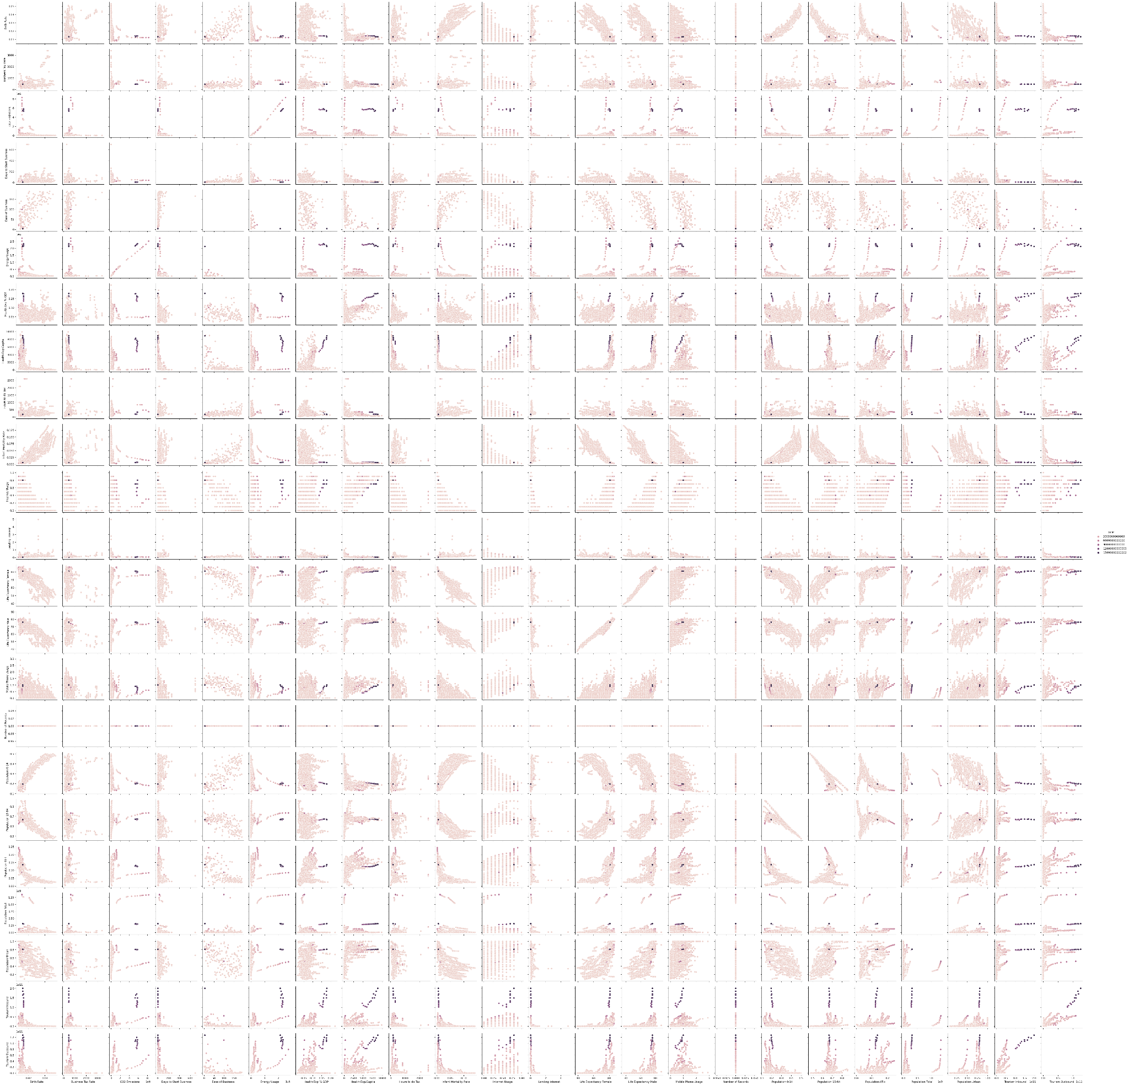
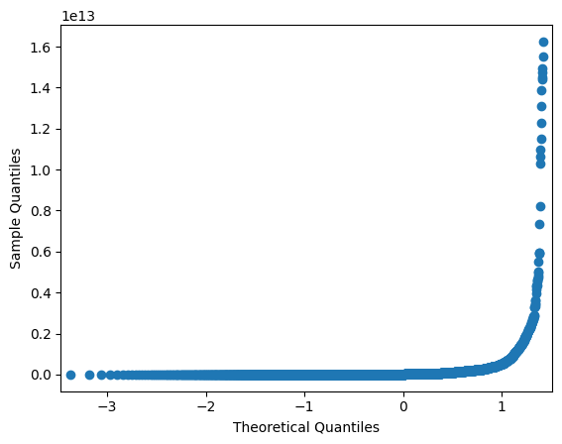
Model Building
Pairplots
qq-plot

Slide 13
Model Building and Evaluation
Necessary libraries were imported for clustering
Renaming the columns in the data frames by removing the spaces etc.,
K – Means Clustering:
K- Means Clustering was assigned to find out the possible number of clusters in our data set.
Using Elbow curve, we identified 3 major clusters in the given data set.
DBSCAN Method:
DBSCAN method was assigned to find out the possible number of clusters and number of noise points in our data set.
We identified 2 major clusters using epsilon values and minimum samples.
Hierarchical Clustering
We performed the Agglomerative clustering
Dendrogram plotting was done.
2 clusters were identified using the single method.
3 clusters were identified using the complete method.

Slide 14
Insights From the Model Building and Evaluation
The Various scores obtained from the model evaluation are:
Score | K-Means | DB SCAN | Hierachical | Inference
Silhouette Coefficient | 0.956 | 0.481 | 0.936 | better is the model
Calinski Harabasz Score | 9532.076 | 127.107 | 2725.219 | better is the model
Davies-Bouldin Index | 0.261 | 0.904 | 0.199 | better is the model
Among the three models that were implemented, K-Means Clustering is the best by observing the above data from the table.

Slide 15
Model Deployment using streamlit library
using Platforms- VS Code and Spyder

Slide 16
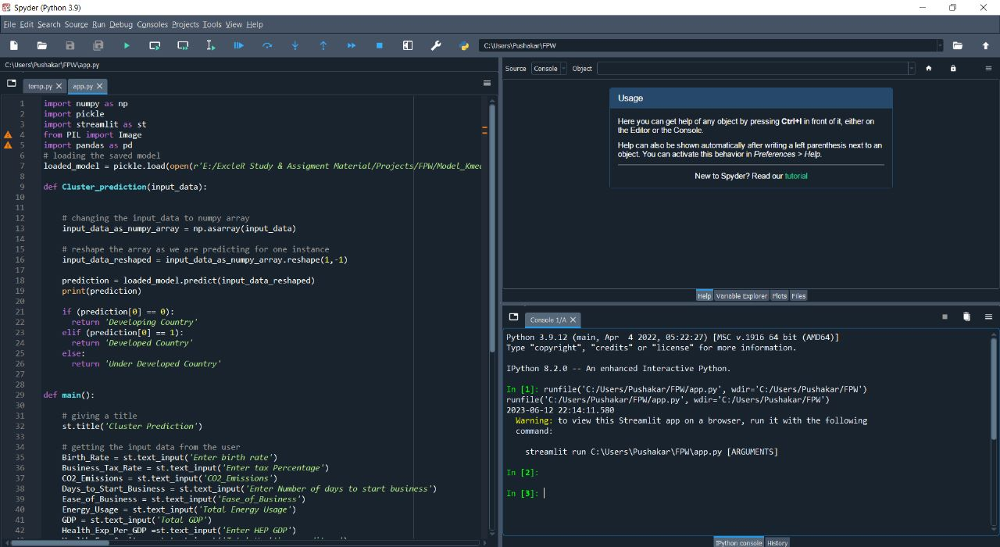
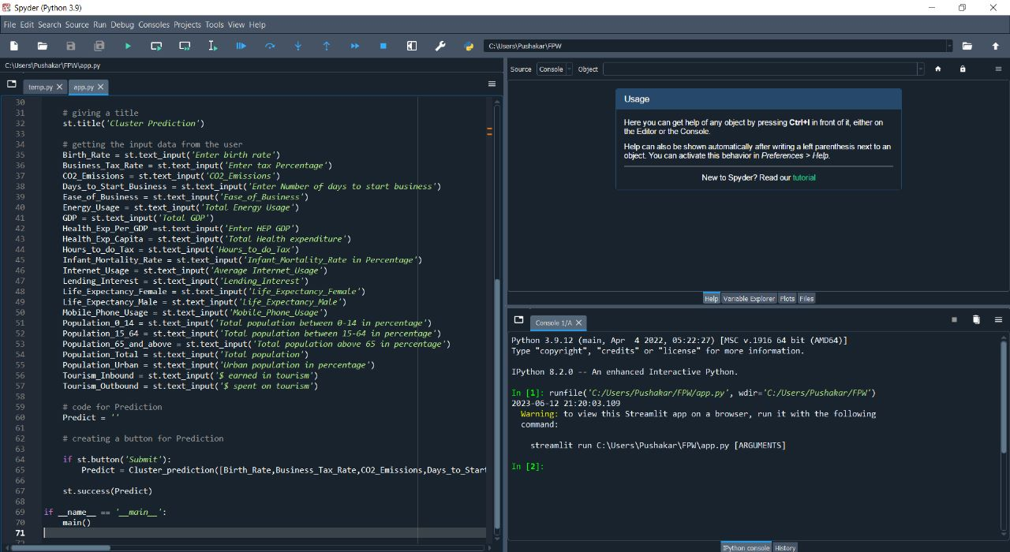
Spyder Platform

Slide 17
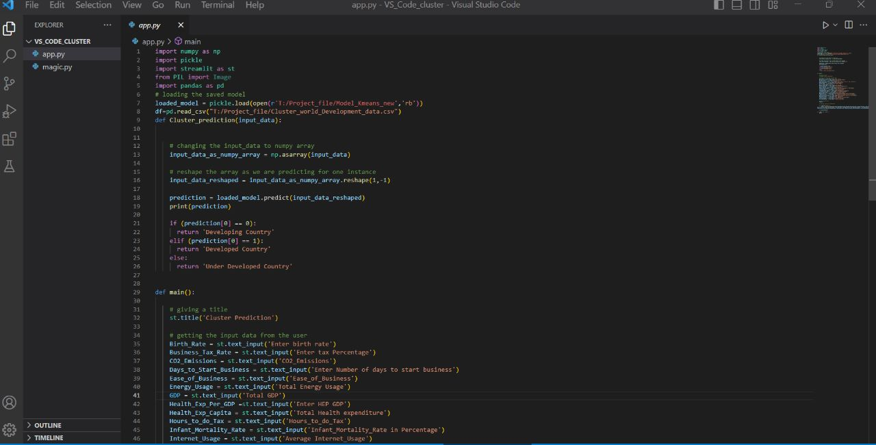
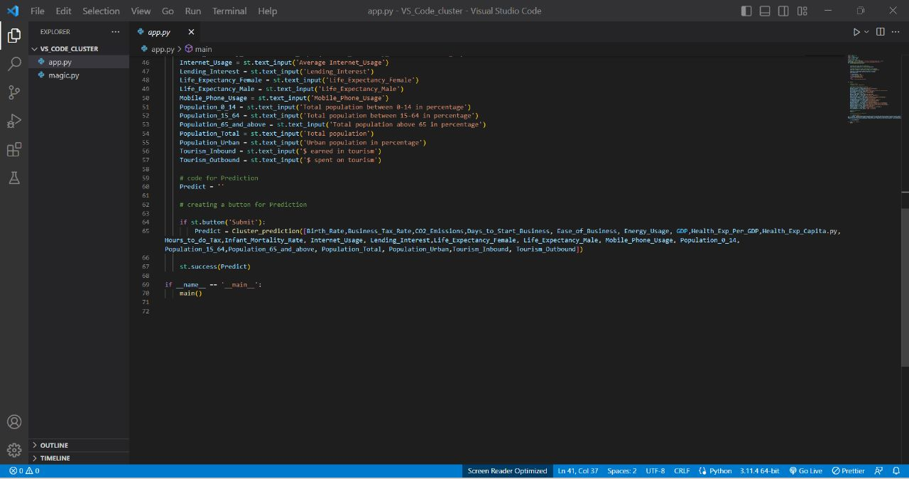
VS Code Platform

Slide 18
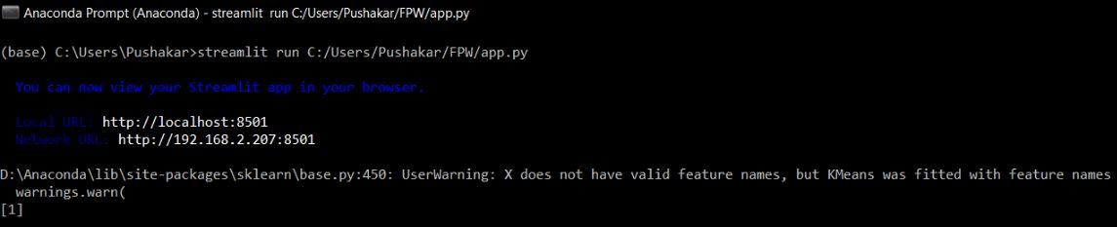
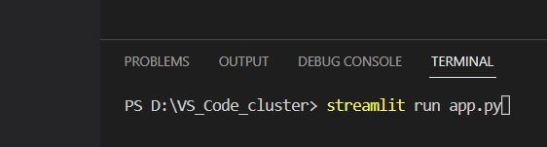
Spyder Streamlit Input
VS Code Streamlit Input

Slide 19
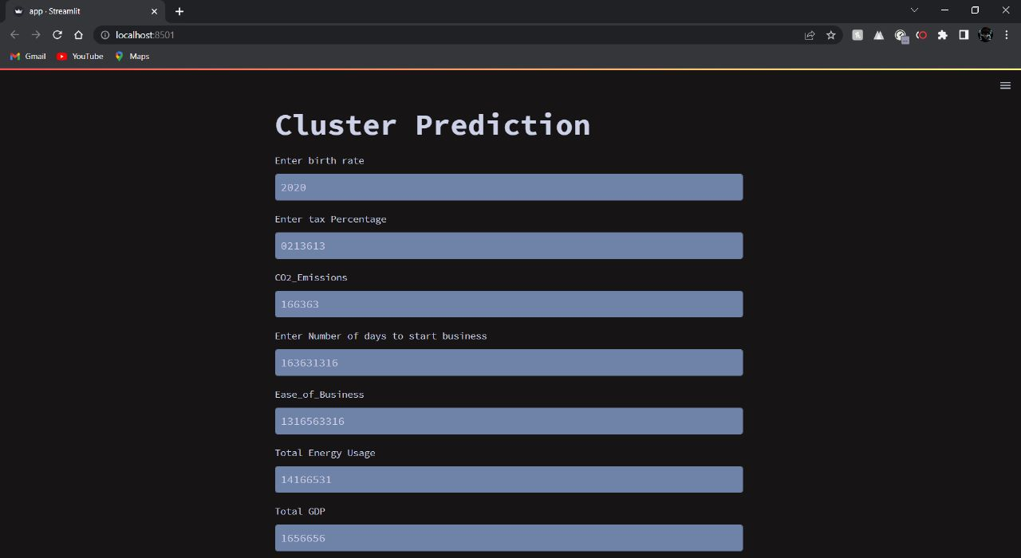
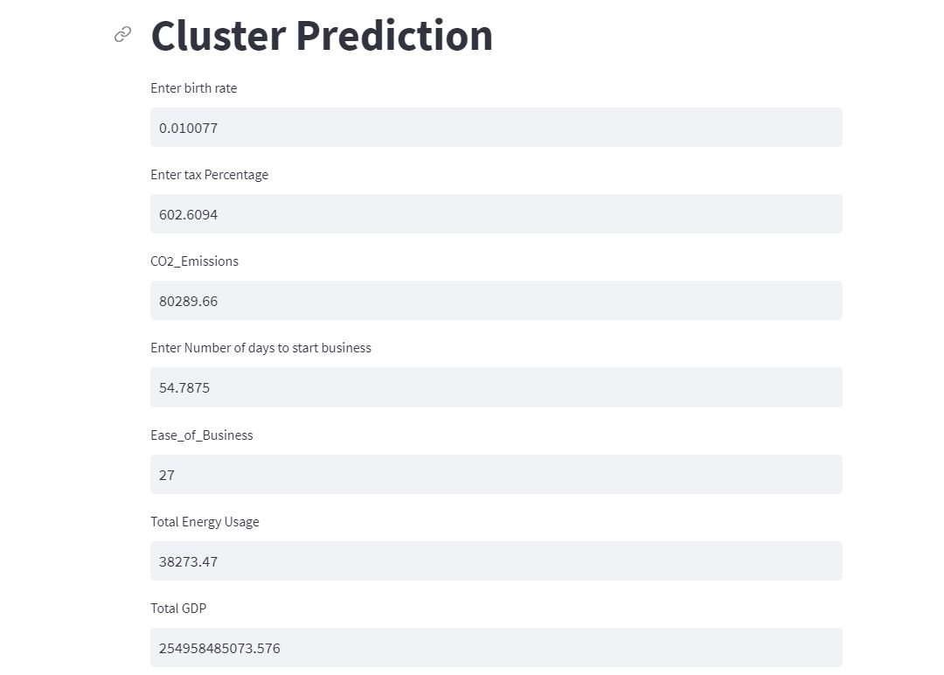
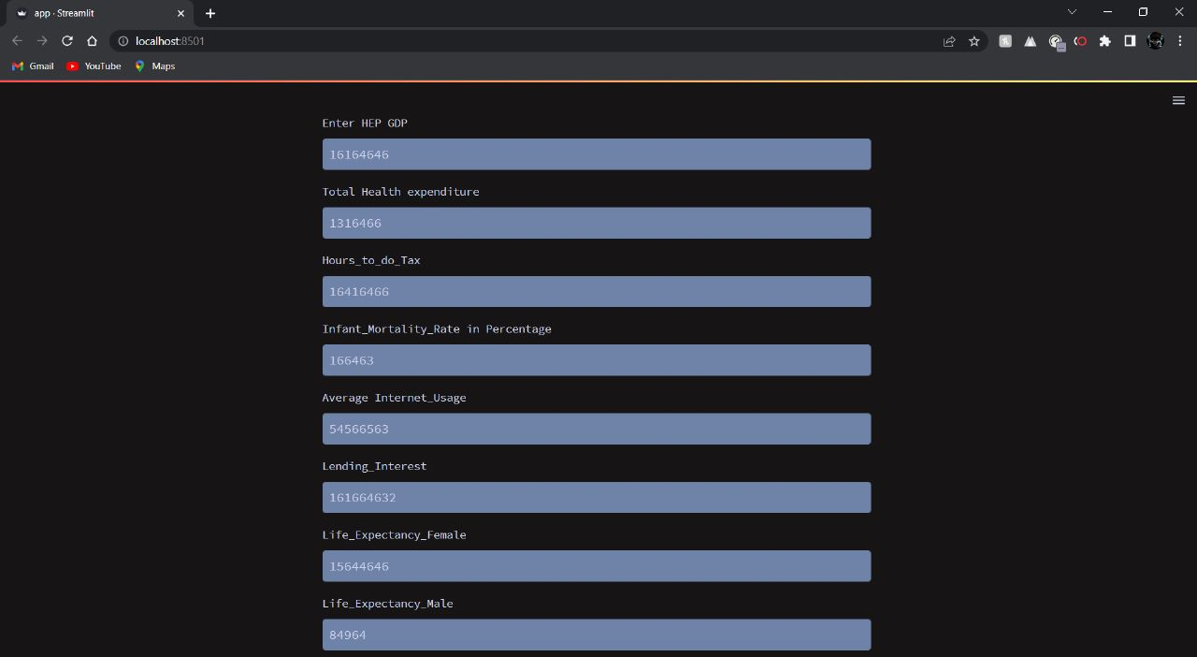
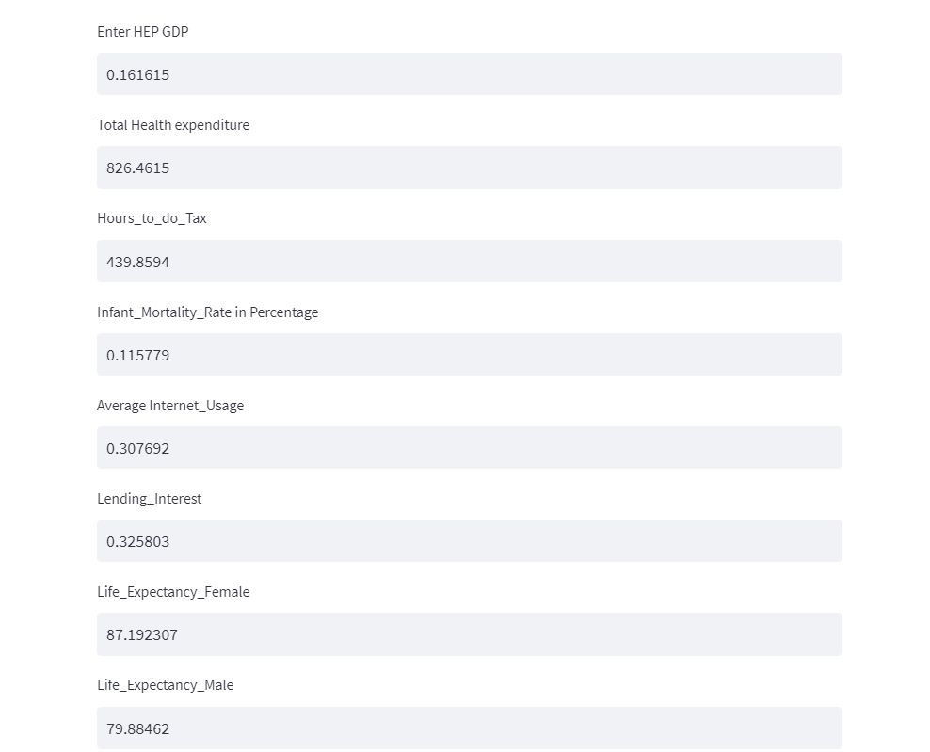
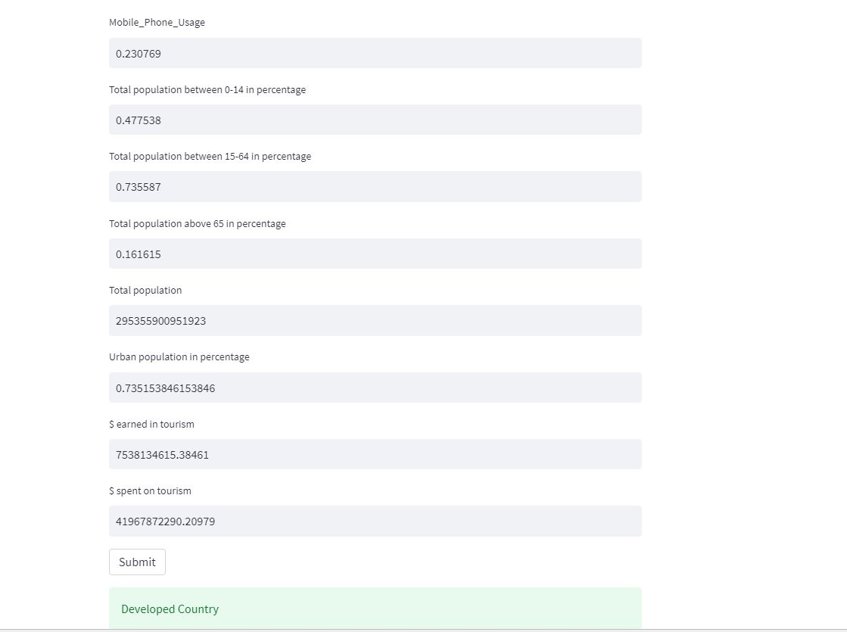
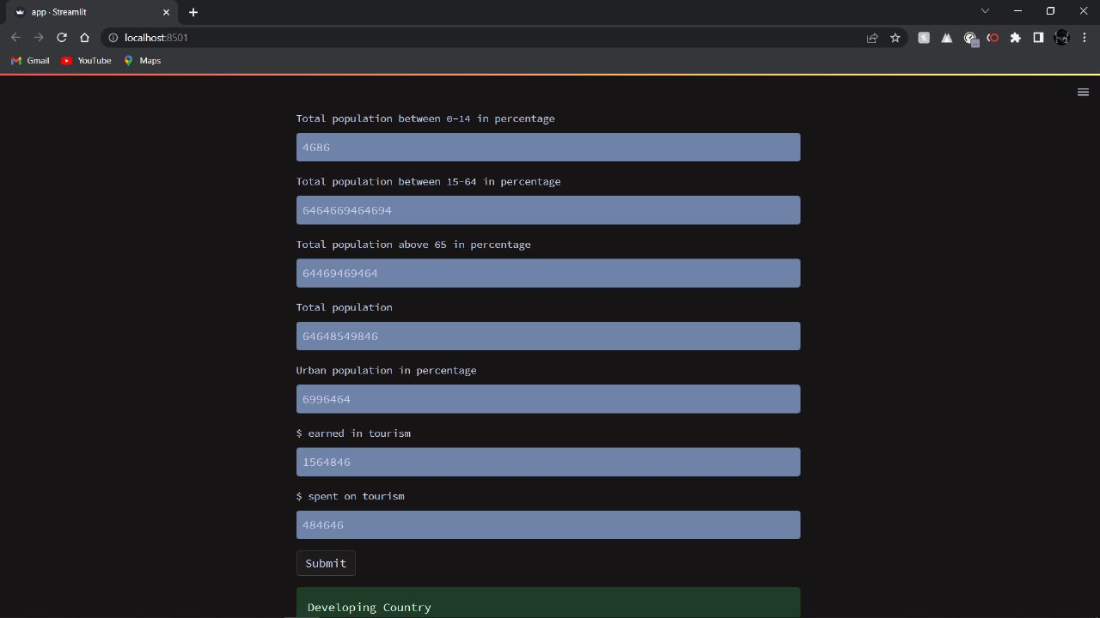
Spyder
VS Code

Slide 20
Challenges faced?
The deployment part has given a great difficulty in the understanding part .
A lot of effort was kept in searching up for the code online, and the sources were no where reliable to us.
A precise answer was never sought to us.
How did you overcome?
All the members approached our respective teachers.
We retrieved necessary inputs from our teachers and friends.
Various platforms were used .
Finally we achieved the deployment part for cluster analysis.

Slide 21
Thank you

